Slide 1

Density-functional theory
Adam J. Jackson
Theoretical and Computational Physics Group,
Scientific Computing, STFC Rutherford Appleton Laboratory

Slide 2
Outline
Atomistic black boxes
Peeking inside the black box: a bit of theory
What can DFT do for me?
Getting started: practical considerations

Slide 3
Atomistic simulations
In atomistic simulations, the fundamental modelling units are atoms. As opposed to:
Finite-element analysis (typically divide by small volumes of solid or liquid)
Coarse-grained simulations (protein, polymer units)
Subatomic particle physics
We can loosely group atomistic simulations into:
Interatomic force fields (parametrised models, atom positions)
Electronic structure (solve behaviour of electrons)
A few electronic structure approaches exist: while simplified semi-empirical and tight-binding methods have their uses, the “workhorse” DFT is ab initio

Slide 4



An ab initio black box
“Ab initio” calculations are based on fundamental physics; they don’t need special information about your system. How do we interact with these methods?
Energy
Nuclei
(point charges!)
(With magnetic moments?)
Phase stability
Forces
Kinetics
N electrons
Spectra
Boundary conditions
Fame and glory

Slide 5

The reality of ab initio methods
There seem to be quite a lot of parameters to play with…
(Photo: Franz Schuier, CC-by 2.0)

Slide 6
Precision and accuracy
Some parameters concern numerical precision and can be systematically improved towards a “correct” result
E.g. numerical grid sizes
Usually a compromise with computational cost
Other parameters will affect overall accuracy
E.g. physics approximations
effects are less predictable
May require more knowledge of problem, testing, system-dependence

Slide 7
Inside the black box: electronic structure methods
Looking to solve the time-independent Schrödinger equation (above)
The nuclei define some Coulomb interactions in the Hamiltonian operator
Solve eigenvalue problem for energy states (eigenvalues) and electronic wavefunctions (eigenvectors)
For one nucleus and one electron, solutions give hydrogen-like orbitals
Born–Oppenheimer approximation: nuclei are slow compared to electrons

Slide 8
Inside the black box: electronic structure methods
Things get more tricky when dealing with multiple electrons
Work with a set of one-electron wavefunctions to keep maths tractable (Hartree approximation)
Let electrons respond to a “mean field” of other electrons
As well as Coulombic interactions, electrons interact through an anti-symmetry property related to Pauli exclusion principle
Putting this together yields the Hartree–Fock method: solve iteratively by minimising energy sum over occupied orbitals.
Notes:
h is one-electron Hamiltonian: KE + nuclear Coulomb interactions I is the Coulomb operator between electrons
X is the exchange operator which handles the antisymmetry
Epsilon is energy of single-electron state, psi is wavefunction
To solve a whole set of these simultaneously, we define total energy by summing energies of occupied orbitals, and iteratively improve wavefunctions to minimize that energy.

Slide 9
Inside the black box: Problems with Hartree–Fock
Somewhat expensive O(n⁴)
Biggest problem is the neglect of correlation: mean-field sum over other electrons assumes they are independent
Various “post-HF” methods address this by building further calculations on top of a HF starting-point. They are expensive and have their uses, but for most of the applications discussed in this lecture DFT is preferred.
Alternatively we can work towards a similar Hamiltonian including corrections:
Notes:
Szabo and Ostlund explanation of correlation:
An example of correlated probabilities is provided by 2 hot potatoes and 2 cold apples in a bucket.
The probability of obtaining a hot potato upon randomly withdrawing an object from the bucket (1/2)
is not equal to the product of the probability of getting a hot object (1/2) times the probability of getting a potato (1/2)
since whether the object is hot is perfectly correlated with whether the object is a potato

Slide 10
Density functionals
A landmark paper by Hohenberg & Kohn (1964) proves that every external potential (i.e. arrangement of nuclei) yields a unique electron density field ρ(r).
Therefore each density defines a unique external potential
Therefore density defines the Hamiltonian and all ground-state properties
Operators like F are a function on a function: known as a functional
The good news: ρ(r) is a 3–D field, however many electrons we have
The bad news: H–K tell us nothing about the form of these functionals

Slide 11
Kohn–Sham DFT
The Kohn–Sham method introduces density functionals while still using single-electron ”orbitals” for some purposes.
These orbitals 𝜙_{i} are variously described “auxiliary”, “fictitious” or “non-interacting”. They are summed to create a density and differentiated to obtain a kinetic energy.
E_{XC}(ρ(r)) is the “exchange-correlation functional”

Slide 12
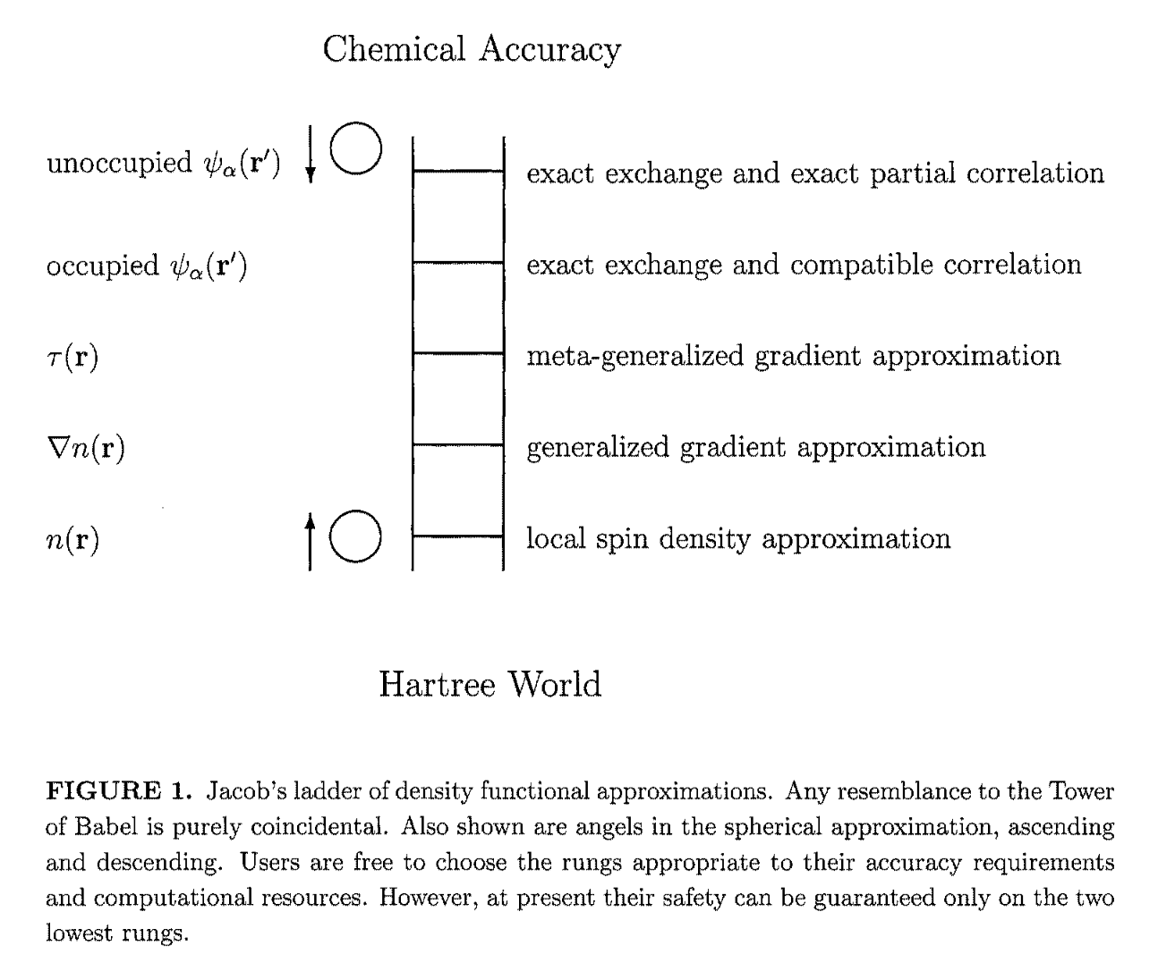
XC functionals
The XC functional’s job is to correct for all the other errors and give correct results!
Based on local density and derivative terms… as we move up the ladder we gain more parameters and make more choices
J. P. Perdew & K. Schmidt (2001) AIP Conference Proceedings 577, 1

Slide 13
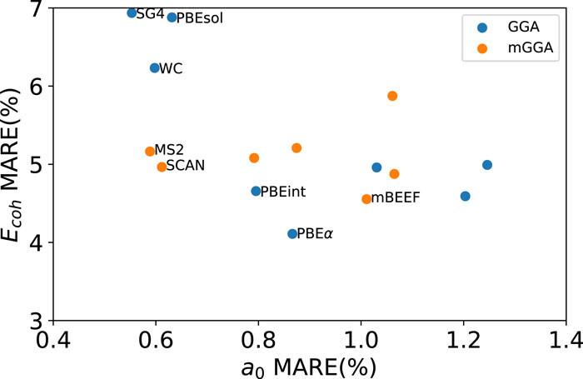
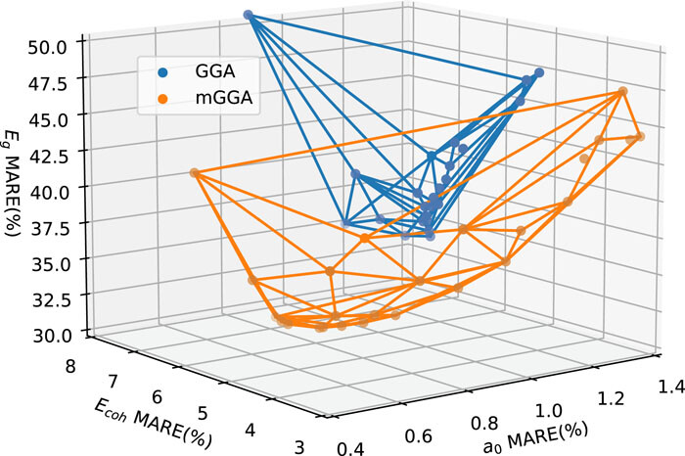
XC functionals
XC functional design can be seen as a parameter optimisation
e.g. recent paper “What is the optimal mGGA exchange functional for solids?“
P. Kovács, F. Tran, P. Blaha, G. K. H. Madsen (2022) J. Chem. Phys. 157, 094110

Slide 14
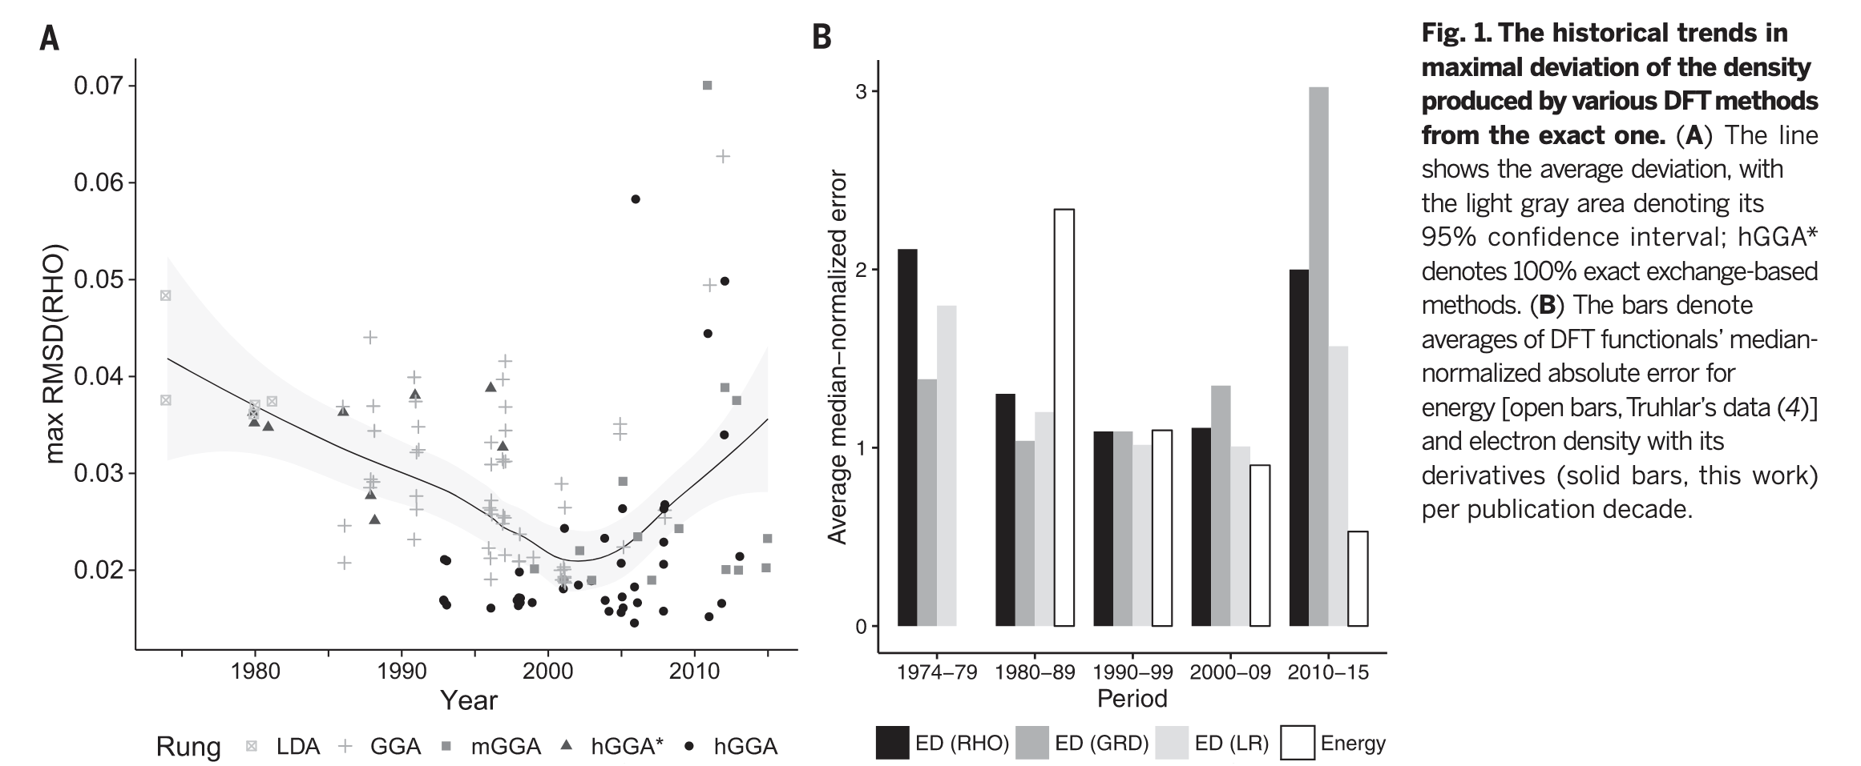
XC functionals
But we should also beware of overfitting to certain properties: controversial paper “Density functional theory is straying from the path toward the exact functional”
finds energy predictions getting better over time, but density getting worse!
M G. Medvedev I. S. Bushmarinov, J. Sun, J, P. Perdew, K. A. Lyssenko (2017) Science 355 (6320) 49

Slide 15
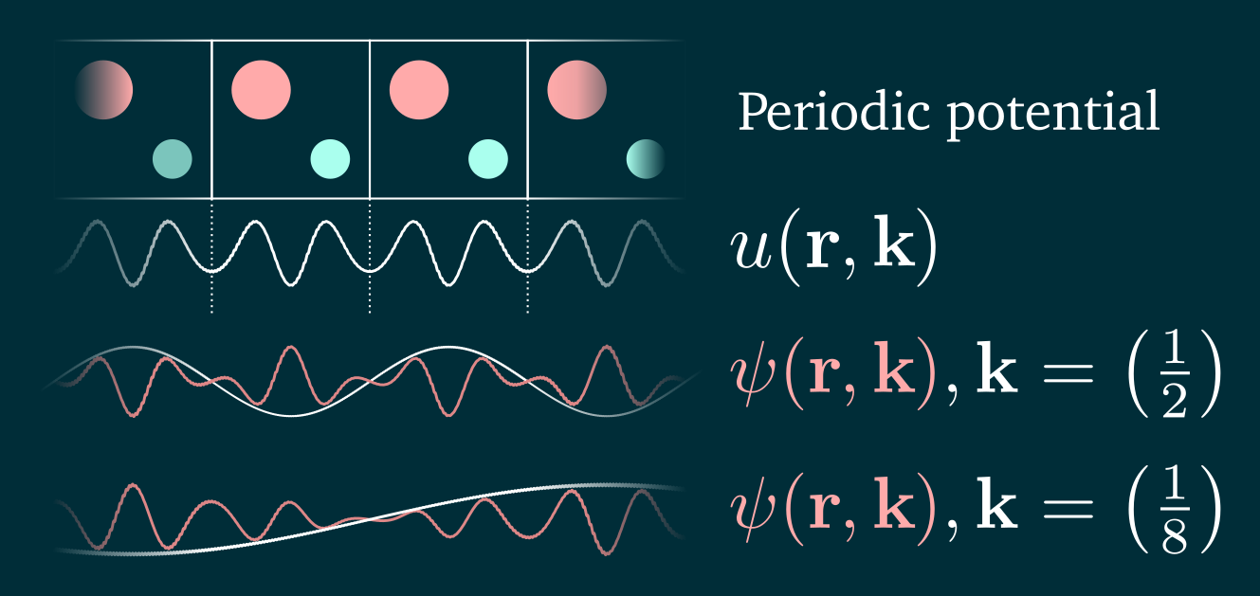
Periodic systems: Bloch’s theorem
Infinite crystals are described with periodic boundary conditions.
Long-range wavefunctions can be described using Bloch waves: product of a periodic function (unit-cell-sized!) and plane wave.
With enough k-points, properties should converge…

Slide 16
Basis sets
How do we actually represent Ψ or 𝜙?
It’s difficult to solve for an unknown function
It’s easy to solve for a linear combination of components
Represent unknown function as a linear combination of known functions: a basis set
Many different basis sets are used in DFT; technical choice.

Slide 17











Basis sets: pros/cons
Regular grid points
Local orbitals
SPARC
Plane waves

Slide 18
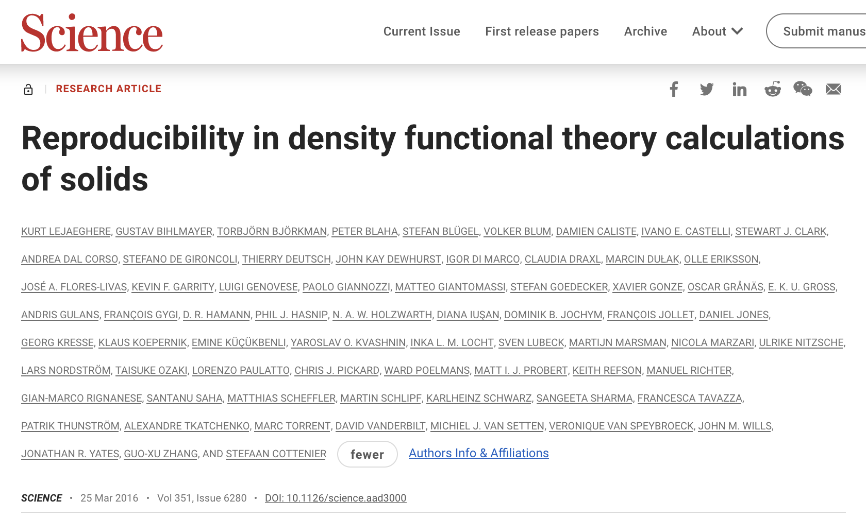
That’s a lot of options!
There are a lot of DFT codes and some questions about the accuracy of some technical choices: basis sets, pseudopotentials etc.
So a study was performed across many different codes, performing equivalent equation-of-state calculations for solids.
Result: they agree pretty well!
(for more recent code versions)
(if you know what you are doing)
Notes:
69 authors on a Science paper, representing lots of codes!

Slide 19
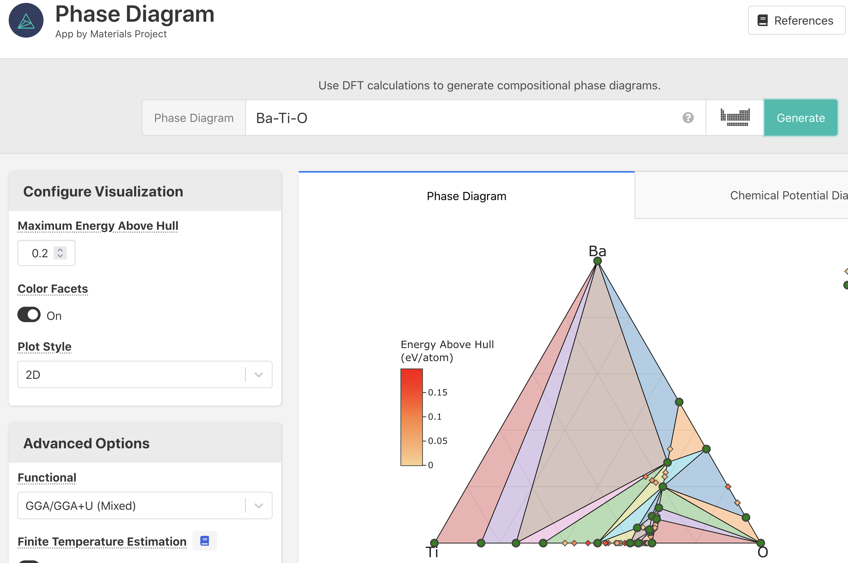
What can DFT do for me? Energies
The most direct output of a DFT calculation is a “total energy”.
These are not directly useful: need to compare with other energies
Be careful comparing energies from calculations with different settings
Do not compare total energies from different XC functionals
DFT energies are “athermal”; neglect vibrations, even ZPE
With a large set of energies, we can predict phase stability, choose between magnetic / ionic ordering, estimate heat of reaction…
Try https://materialsproject.org for a database of existing solid-state data

Slide 20
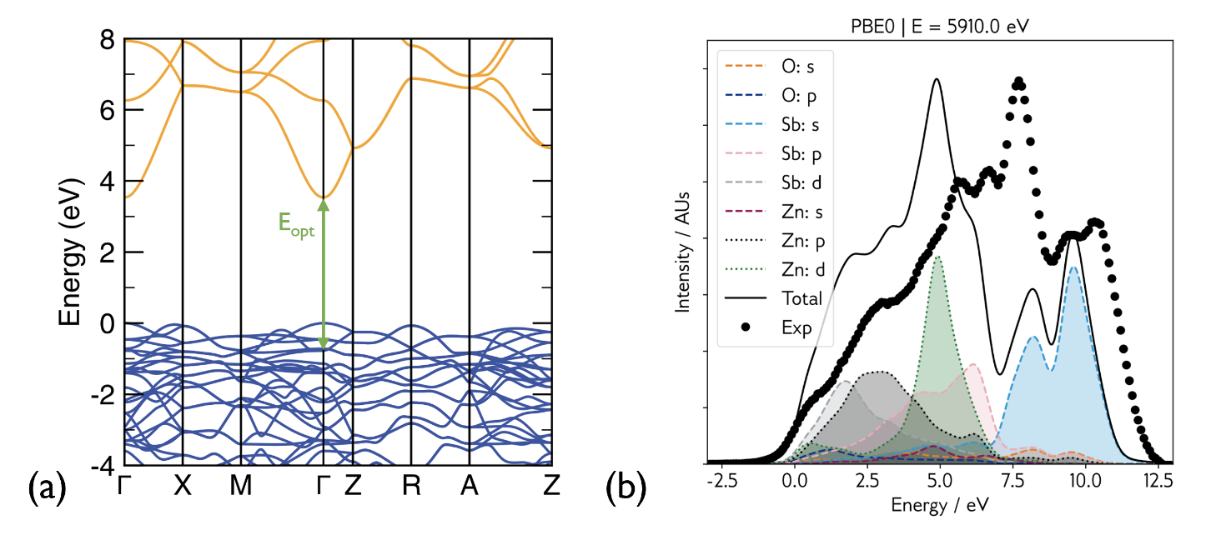

What can DFT do for me? Orbital energies
If we examine the shapes and energies of Kohn–Sham orbitals, we get pretty reasonable-looking information about electronic structure.
https://doi.org/10.1021/acsenergylett.2c01961
Here be dragons
LDA, GGA tend to under-estimate electronic bandgap
Hartree–Fock tends to over-estimate it ”Hybrid” functionals fall somewhere in the middle
This isn’t really supposed to work;
K–S theory doesn’t promise it will.
But in practice results very useful…

Slide 21
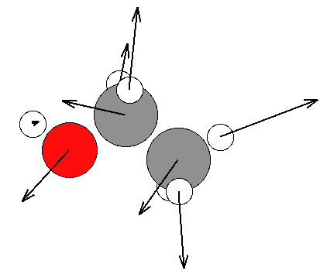
What can DFT do for me? Forces
The Hellmann–Feynman theorem allows forces to be calculated quite inexpensively.
Typically structures are optimised by adjusting positions and lattice parameters to minimise the energy; this is much more efficient when forces are available.
This information also helps explore the “potential energy landscape” searching for transition states
(i.e. reaction barriers ➞ kinetics)
Ethanol molecule optimization with LBFGS algorithm

Slide 22
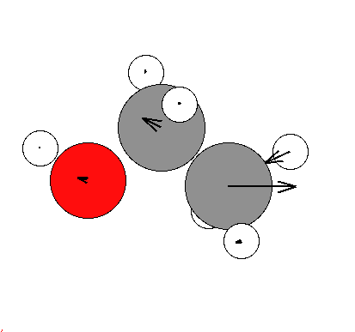
What can DFT do for me? Vibrations
In the harmonic approximation, vibrations are driven by linear spring-like interactions between each pair of molecules. This can be collected as a matrix of force constants.
Zero for “relaxed”
structure
Anharmonic terms
Force constant matrix Φ_{ij} can be filled in a row at a time by making small displacements along each degree of freedom

Slide 23
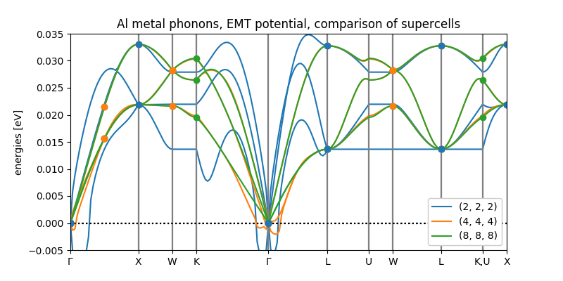
What can DFT do for me? Phonons
For a periodic system the same principle applies, but we may need to use a large “supercell” to avoid self-interaction and get correct information about low-symmetry q-points
Interactive visualisations:
http://henriquemiranda.github.io/phononwebsite/phonon.html

Slide 24
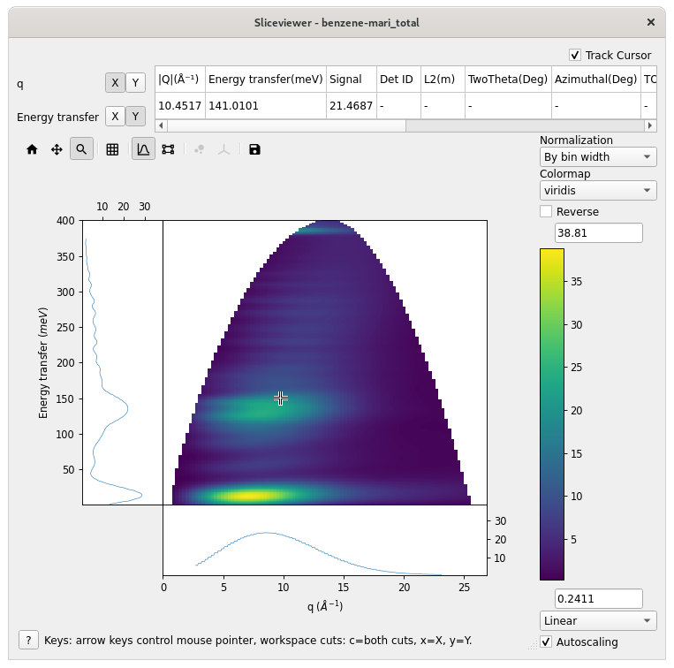
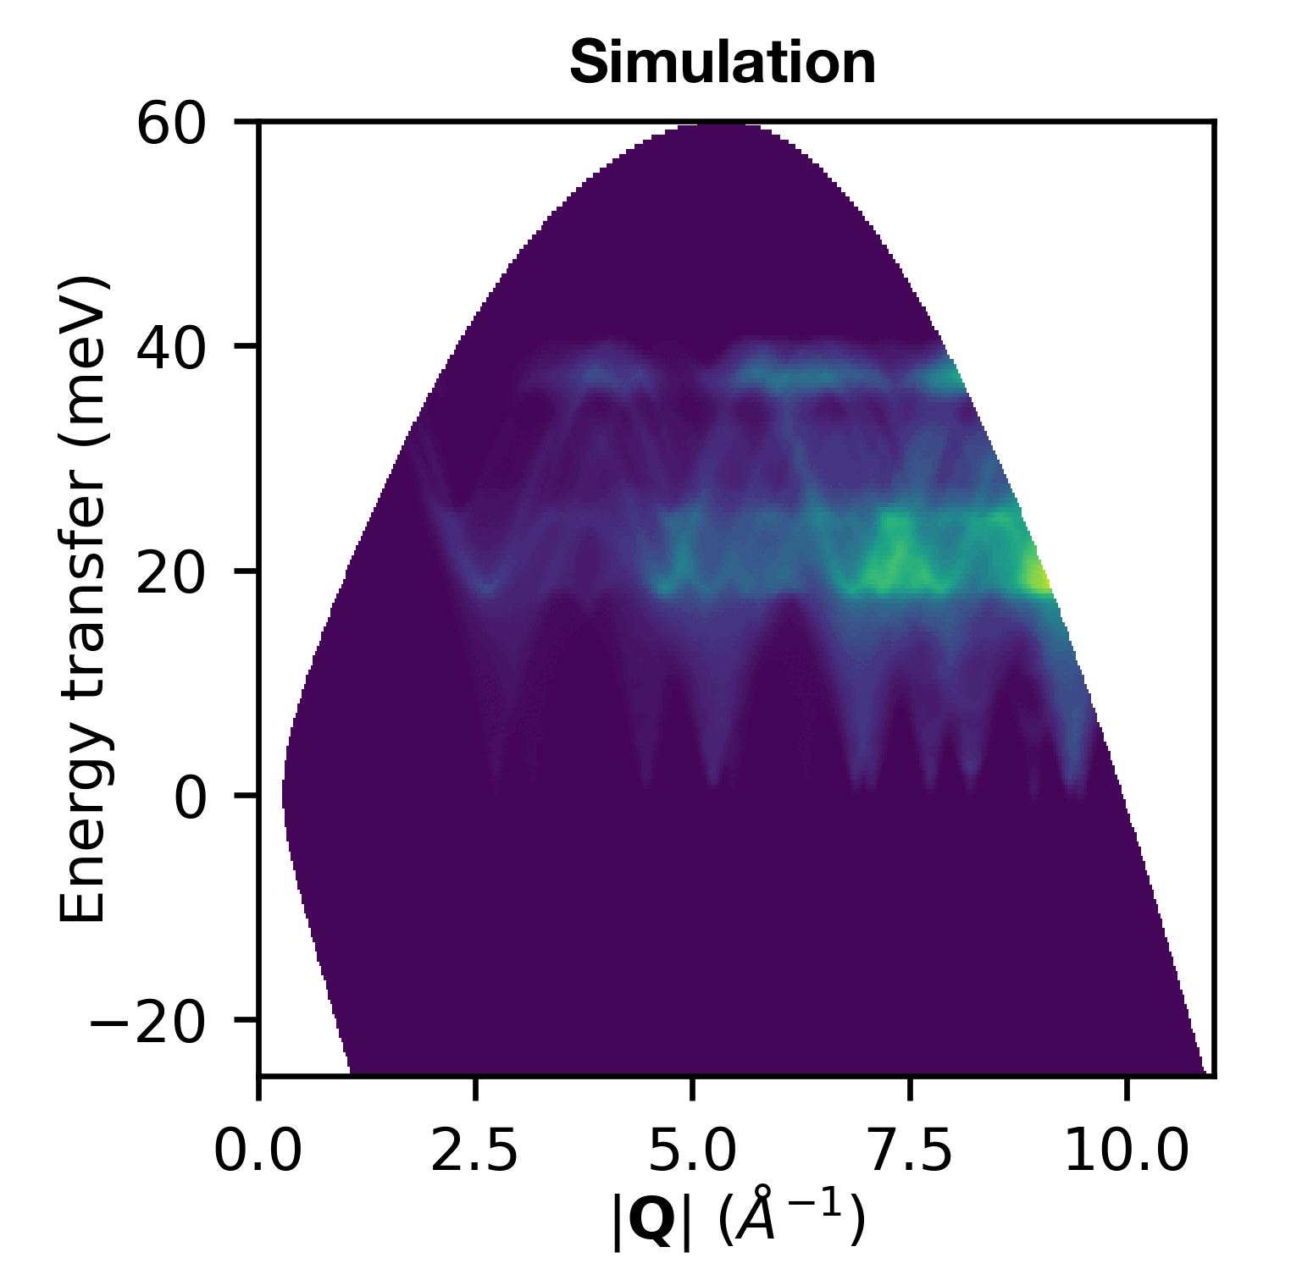

What can I do with these phonons?
Codes developed at ISIS for simulation of inelastic neutron scattering spectra
AbINS: incoherent approximation, DOS-like analytic powder-averaging, instrumental resolution functions, multi-phonon scattering (Good for molecular crystals)
Euphonic: coherent scattering, single-crystal and numerical powder-averaging, simple broadening
(Good for solids, inorganic)

Slide 25
Ok, sounds great. What do I need?
A suitable problem
Software
Computers
Guidance

Slide 26
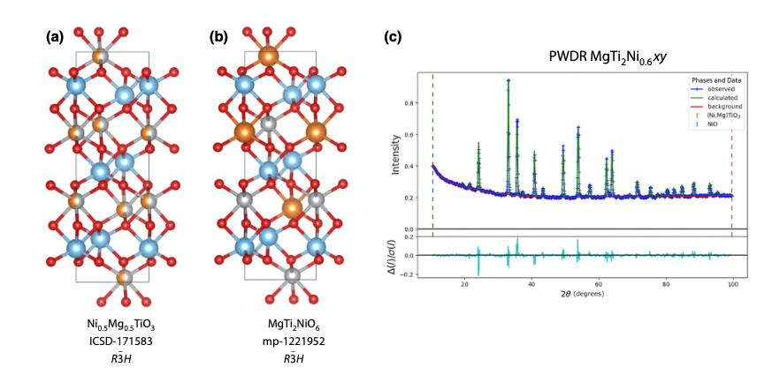
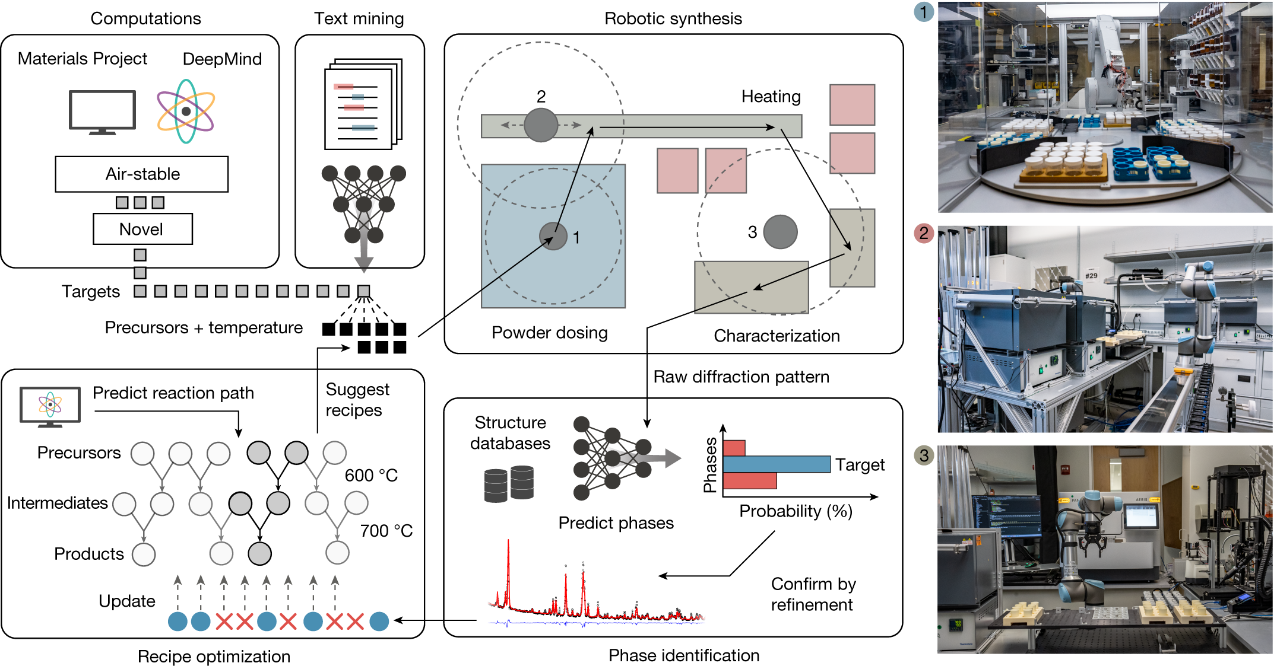
A suitable problem
Atomic positions need to come from somewhere
Hypothesised structure
Diffraction data (x-ray or neutron)
Hydrogen may be missing
Average sites may differ from ground state
Fractional occupancy is a problem
“A-Lab” project, Nature paper claimed to discover 41 novel compounds
Critics observed that XRD cannot distinguish the majority of these from known disordered phases
DOI:10.1038/s41586-023-06734-w
DOI:10.1103/PRXEnergy.3.011002

Slide 27
A suitable problem
Atomic positions need to come from somewhere
Hypothesised structure
Diffraction data (x-ray or neutron)
Hydrogen may be missing
Average sites may differ from ground state
Fractional occupancy is a problem
“Global optimisation” algorithm
A more expensive problem…
Magnetic (dis)order can break symmetry and expand the unit cell
Known properties can guide selection of parameters such as XC functional
e.g. lattice parameters, optical bandgap, bulk modulus, …

Slide 28

Software
There are many atomistic “codes”
Some based on different technical choices (e.g. theory, basis set, parallelism)
Some emerging from different communities (target systems, code interfaces)
A lot of “not invented here syndrome” and licensing issues… (open vs commercial vs evolved-from-a-1980s-PhD-project)
Most of them are capable of decent precision, so in practice choose based on
Required features (periodicity, XC functionals, spin-orbit coupling, dispersion)
Computational performance (scaling for small or large systems, GPU support)
Usability (documentation quality, included tools, compatibility with external)
Access (licensing, friendly developers, helpful post-docs)
https://en.wikipedia.org/wiki/List_of_quantum_chemistry_and_solid-state_physics_software
These matrices can be useful: keep in mind they don’t tell which features work simultaneously

Slide 29
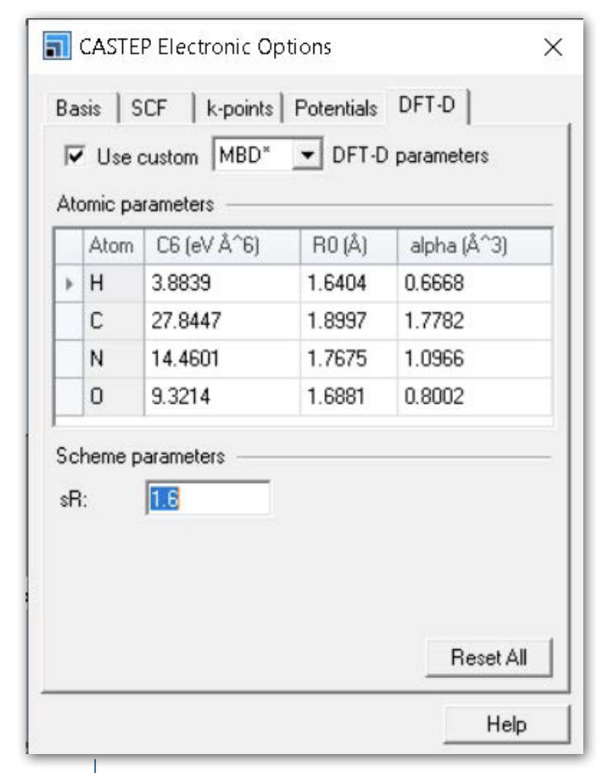
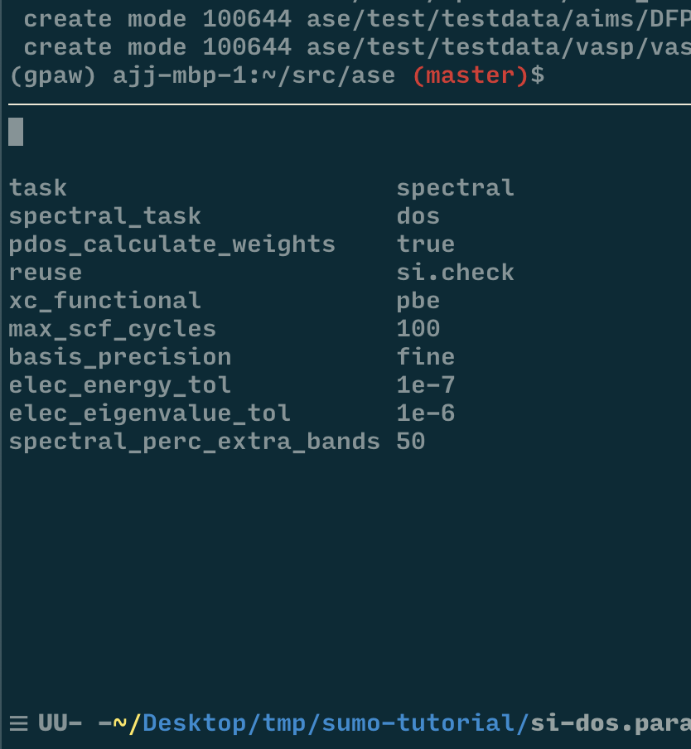
Software
A few codes come with graphical user interfaces that run on Windows (Materials Studio, GaussView) but this costs $$$ and may limit available functionality.
vs
Most codes are developed for use in a Linux(-like) command-line environment. To write input files, automate groups of calculations and compile codes from source code, it is recommended to:
Get a bit of familiarity with the Bash shell
Learn how to use a text editor effectively
(Optional) use Python for more advanced manipulation and plotting

Slide 30

Computers
Modern DFT codes will run on a laptop, a 750,000-core supercomputer, or most things in-between.
Personal computers can generally handle tens of atoms with GGA functionals.
A high-end workstation will go slightly bigger… or run a lot of those calculations more quickly and reliably.
Academic clusters become necessary when going to larger unit cells, heavy elements, hybrid DFT, spin-orbit coupling…
UK national supercomputer: ARCHER2
2x cores only means 2x faster if your problem breaks down very well! Check scaling efficiency and test parallelism options.

Slide 31
Guidance
This was just an overview!
Find out what codes people in your field are using for similar systems
See if you can get a copy of their parameter files and understand what options were chosen and what implications they have
Talk to experts to see if what you are trying to do is reasonable: DFT is not always a practical option
For larger simulation regions, the practical options might be trained against a set of smaller DFT calculations
Some systems are known to be tricky: highly-correlated materials, liquids and glasses, unstable phases, excited states…

Slide 32
Recap: how to read a DFT methods section
“We used DFT” is not enough information to reproduce a calculation!
Neither is “we used CASTEP”
Most important information are the “accuracy parameters” defining approximations made: XC functional, spin treatment, dispersion…
Also useful are “precision” details: basis set, pseudopotentials, k-point sampling, convergence thresholds
Best practice: include parameter files in the SI!

Slide 33

Thank you
scd.stfc.ac.uk
@SciComp_STFC

